Slide 1


Bring yourself up to speed with PowerShell
Toni Frankola
14 octobre 2017
#SPSParis
Notes:
The PowerShell has been with us since SharePoint 2010 and has substantially evolved over the course of last eight years. In this session, we are going to discuss how PowerShell has evolved to be the most important tool in the IT PROs toolbox. In this session, we are going to discuss the new features that rolled out with PowerShell v5, we are going to learn more about desired state configuration, CredSSP, PowerShell remoting, and PnP PowerShell scripts. On top of that, we are going to spend a fair amount of time discussing some scripts that can help SharePoint admins automate many day-to-day tasks like site provisioning, backups, adding new servers, services and farms.

Slide 2
Sponsor slide to come before conference.

Slide 3
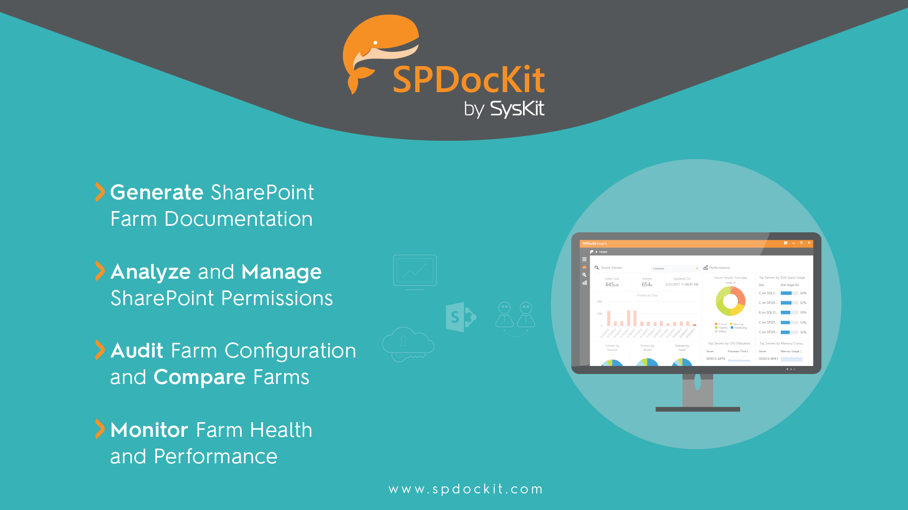

Slide 4
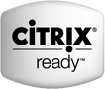


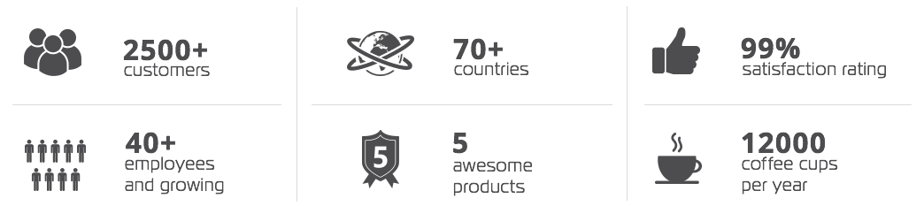
SysKit is a software development company based in Zagreb, Croatia, Europe founded in 2009.
We create innovative software solutions for SharePoint, Office 365, SQL Server, RDS, and Citrix admins and consultants.​
Technology Partners

Slide 5
SPDocKit
Microsoft SharePoint Administration
Governance
Reports
Documentation
Management
www.syskit.com

Slide 6
SharePoint Documentation, Reporting & Management
Farm Documentation
Track Changes and Compare
Governance – Queries & Rules
Content and Usage Reports
Permissions Management & Reports
Farm Audit – Best Practices
Once upon a time there was a tool that could help you create a SharePoint farm documentation with just a few clicks...
It grew and became....
The ultimate SharePoint admin tool for every admin and consultant!

Slide 7



SPDocKit Benefits
Developed for administrators and consultants to automate routine administrator tasks.
Enhance SharePoint farm performance, save time, prevent and detect potential issues.
Maintain high productivity and business continuity. Increase data security. Save money.

Slide 8
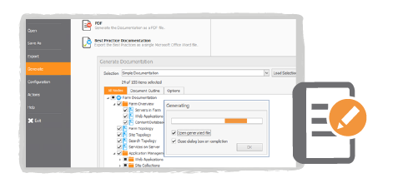
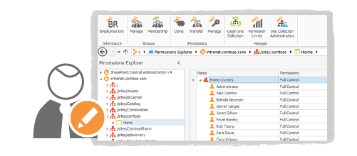
Microsoft SharePoint administration, governance & reporting
Generate Farm Documentation
Contains all of the system and configuration settings
Saves hours of manually pasting data
Manage Permissions
Audit changes and modify Microsoft SharePoint permissions
Edit, clone, and transfer permissions between users and groups + restore!

Slide 9
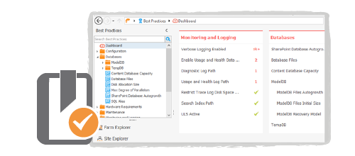
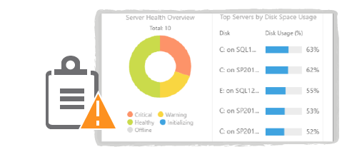
Microsoft SharePoint administration, governance & reporting
Audit Farm Configuration
Examine your farm settings according to the community best practices
Generate reports and export documentation
Monitor Farm Health & Performance
A powerful collecting engine gathers all ULS, SQL and Windows Event Logs into one console
Monitor key performance counters for all servers in your Microsoft SharePoint farm

Slide 10
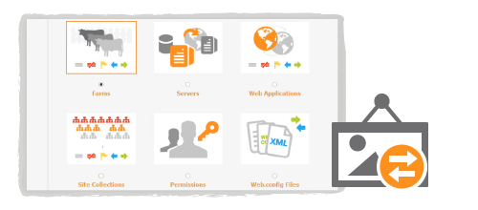
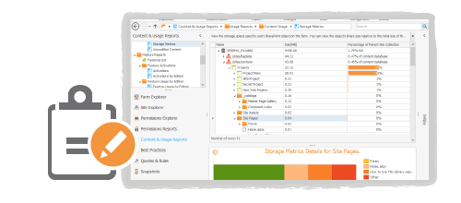
Microsoft SharePoint administration, governance & reporting
Compare Wizard
Compare DEV, Production, QA & Staging farms
Additional: Permissions, Web Apps, Site Collections, Servers, Web.config files
Track all the modifications
Content and Usage reports
Get a detailed information about farm storage, Microsoft SharePoint structure and content usage

Slide 11


SharePoint Online
Create snapshots – live and historical data!
Manage permissions for users and groups
Create numerous reports
Report on all users and groups and review their permissions
Detect unique permissions and manage broken inheritance
Review the site collection, subsite and list hierarchy
Track externally shared content and users with new reports!

Slide 12
SysKit Pulse
Free Server Monitoring Tool
www.syskit.com

Slide 13

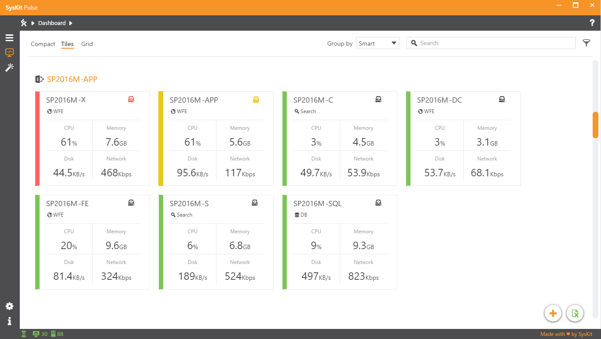
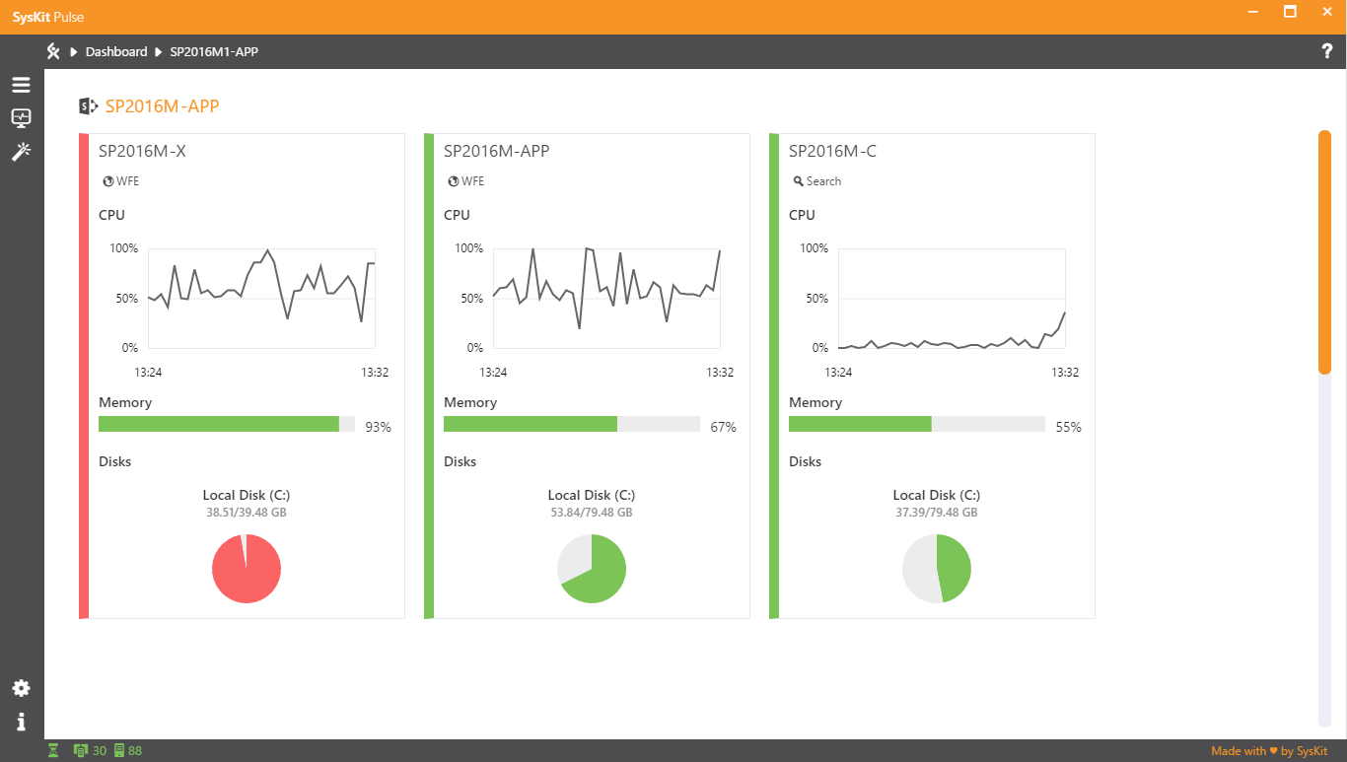
Autodiscover Microsoft SharePoint farms and accompanying servers, as well as Microsoft SQL Servers, in all your domains
Audit the most important performance counters

Slide 14
Agenda
Tools
AutoSPInstaller
Commandlets
Modules + Gallery
DSC
PnP PowerShell

Slide 15
Tools
PowerShell Shell
SharePoint 2016 Management Shell
Visual Studio Code https://code.visualstudio.com/

Slide 16
PowerShell 101
Demo 1

Slide 17
Commandlets

Slide 18
Available commandlets
Access Service cmdlets in SharePoint Server 2016
Administer and configure search in SharePoint Server 2016
Administer security in SharePoint Server 2016
App Management Service cmdlets in SharePoint Server 2016
Backup and recovery cmdlets in SharePoint Server 2016
Database cmdlets in SharePoint Server 2016
Enterprise content management cmdlets in SharePoint Server 2016
Farm cmdlets in SharePoint Server 2016
Features and solutions cmdlets in SharePoint Server 2016
Health monitoring cmdlets in SharePoint Server 2016
Import and export cmdlets in SharePoint Server 2016
InfoPath Services cmdlets in SharePoint Server 2016
Logging and events cmdlets in SharePoint Server 2016
Machine Translation Service applications in SharePoint Server 2016
Manage performance in SharePoint Server 2016
Manage sites in SharePoint Server 2016
Manage timer jobs in SharePoint Server 2016
Managed metadata cmdlets in SharePoint Server 2016
PerformancePoint Services cmdlets in SharePoint Server 2016
Secure Store Service cmdlets in SharePoint Server 2016
Service application cmdlets in SharePoint Server 2016
Site collection cmdlets in SharePoint Server 2016
State service and session state cmdlets in SharePoint Server 2016
Upgrade to SharePoint Server 2016
Use Windows PowerShell cmdlets to administer SharePoint Server 2016
Use Windows PowerShell cmdlets to manage Business Connectivity Services in SharePoint Server 2016
User licenses in SharePoint Server 2016
User Profile service in SharePoint Server 2016
Visio Graphics Services cmdlets in SharePoint Server 2016
Web application cmdlets in SharePoint Server 2016
Word Services cmdlets in SharePoint Server 2016

Slide 19
Commandlets
Demo 2A

Slide 20
Functions
Demo 2B

Slide 21
Modules and PowerShell gallery
A module is a set of related Windows PowerShell functionalities, grouped together as a convenient unit (usually saved in a single directory).
https://www.powershellgallery.com

Slide 22
Modules
Demo 3

Slide 23
AutoSPInstaller

Slide 24
AutoSPInstaller
Demo 4

Slide 25
SharePoint DSC

Slide 26
SharePoint DSC
Demo 5

Slide 27
PnP PowerShell
SharePoint Patterns and Practices (PnP) contains a library of PowerShell commands (PnP PowerShell) that allows you to perform complex provisioning and artifact management actions towards SharePoint. The commands use CSOM and can work against both SharePoint Online as SharePoint On-Premises.
https://msdn.microsoft.com/en-us/pnp_powershell/pnp-powershell-overview
SharePoint Version | Command to install
SharePoint Online | Install-Module SharePointPnPPowerShellOnline
SharePoint 2016 | Install-Module SharePointPnPPowerShell2016
SharePoint 2013 | Install-Module SharePointPnPPowerShell2013

Slide 28
PnP PowerShell Areas
Apps
Base Cmdlets
Branding
Client-Side Pages
Content Types
Document Sets
Event Receivers
Features
Fields
Files and Folders
Information Management
Lists
Microsoft Graph
Provisioning
Publishing
Records Management
Search
SharePoint Recycle Bin
SharePoint WebHooks
Sites
Taxonomy
Tenant Administration
User and group management
User Profiles
Utilities
Web Parts
Webs
Workflows
https://msdn.microsoft.com/en-us/pnp_powershell/pnp-powershell-overview

Slide 29
PnP PowerShell
Demo 6

Slide 30

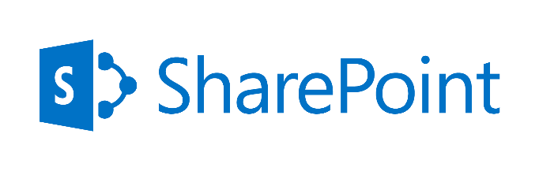


Thank you, for your for #SPSParis

